Slide 1


Electrical Safety
Electrical Subsystems
Electrical Hazards
Power Supply Components
Power Distribution Components
Power Consuming Components
Safety Hazard from Batteries and Chargers
Safety Hazard from Wire and Component Damage
Electric Shock Precautions

Slide 2
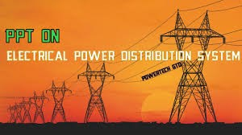
Electrical Subsystems
Power Supply Components
Power Distribution Components
Power Consuming Components

Slide 3
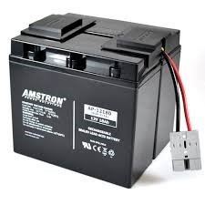
Power Supply Components
Supply power for power consuming components
Consists of:
Supply High-Current
Supply High-Voltage
Battery Chargers
Batteries
High Stored Energy
High-Voltage

Slide 4
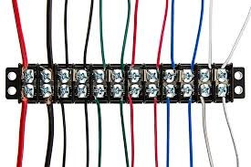
Power Distribution Components
Moves power from power supplies to the power consuming components
Consists of:
Switches
Wiring
Mechanical Switches
Relays
Solid State Relays
Conductors
Insulators
Circuit Protection
Circuit Breakers
Fuses

Slide 5
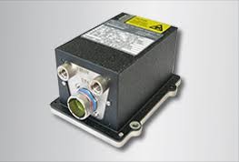
Power Consuming Components
Avionics
Valve Control
Actuators & Controllers
Payloads
Computers
GPS
Inertial Measurement Units
Telemetry
Cameras

Slide 6

Electrical Hazards
Ignition Source
Toxic Smote & Flammable Material
Electrical Shock
Arcing and Sparking
Overheating
Wiring Insulation
Plastic Avionics Boxes
Plastic Connectors
Battery Electrolyte
Wires
Connectors
Components
High-Voltage Batteries

Slide 7
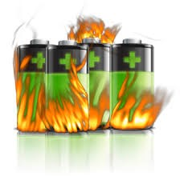
Batteries & Chargers Safety Hazard
Avoid Overcharging
Avoid Over-Discharge
Avoid Damage
Continuous monitoring during charging
Use factory supplied battery charger
Use ground power on the launch pad
Plan your mission battery usage
Avoid overheating
Avoid freezing
Use good mounting
Protect from crushing
Replace when batter parameters are exceeded

Slide 8
Wires & Component Damage Safety Hazard
Avoid Mechanical Damage
Protect against excessive current & short circuits
Clamp and wrap wire bundles to avoid abrasion
Avoid wire bundles frequent flexing
Use connector cable clamps
Inspect
Use circuit protection
Use appropriate ratings
Fuses
Circuit breakers
Fuse links at the battery
Signs of overheating
Signs of damage
Displaced connector pins
Wire gauge
Circuit breaker & fuses

Slide 9

Electric Shock Precautions
Use appropriate voltage rating
Ground the chassis of components
Insulate exposed conductors
Power off before
Components
Wire insulation
Touching
Attaching probes
Mating/demating connectors
Heat shrink tubing
Electrical tape
Potting compound

